Slide 1
Syntax Analysis

Slide 2
Why are Grammars to formally describe Languages Important ?
Precise, easy-to-understand representations
Compiler-writing tools can take grammar and generate a compiler
Allow language to be evolved (new statements, changes to statements, etc.) Languages are not static, but are constantly upgraded to add new features or fix “old” ones.
Why study lexical and syntax analyzers?
Lexical and syntax analysis not just used in compiler design
program listing formatters
programs that compute complexity
programs that analyze and react to configuration files

Slide 3
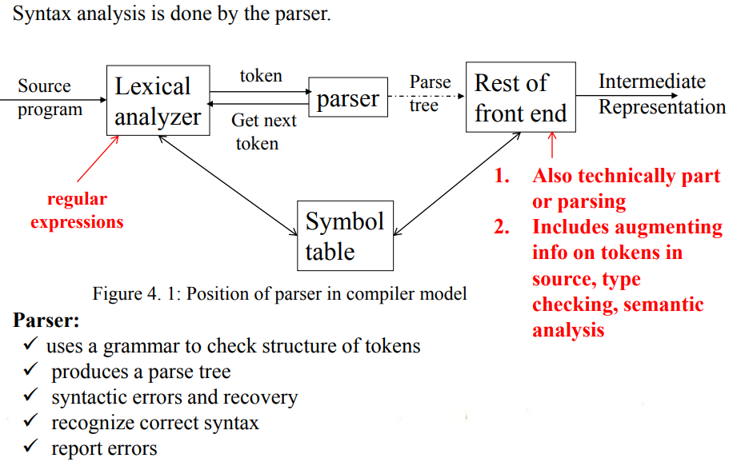

Slide 4
Syntax Error Handling
Lexical errors:
Include misspellings of identifiers, keywords, or operators
Example: the use of an identifier elipseSize instead of ellipseSize – and missing quotes around text intended as a string.
Syntactic errors:
Omission, wrong order of tokens
include misplaced semicolons or extra or missing braces; that is, "{" or "}“.
Semantic errors:
Incompatible types
include type mismatches between operators and operands.
An example is a return statement in a Java method with result type void.
Logical errors:
anything from incorrect reasoning on the part of the programming.
Infinite loop / recursive call

Slide 5
NOTE: Majority of error processing occurs during syntax analysis.
Not all errors are identifiable.
Error handler goals:
Report the presence of errors clearly and accurately.
Recover from each error quickly enough to detect subsequent errors.
Add minimal overhead to the processing of correct programs.

Slide 6
Error-recover strategies:
Panic mode recovery
Discard input symbol one at a time until one of designated set of synchronization tokens is found
The synchronizing tokens are usually delimiters, such as semicolon or }
Advantages:
simple → suited to 1 error per statement
Problems:
skip input → miss declaration – causing more errors
→ miss errors in skipped material
Phrase level recovery
Replacing a prefix of remaining input by some string that allows the parser to continue
Local correction on input is to replace a comma by a semicolon, delete an extraneous semicolon, or insert a missing semicolon.
Not suited to all situations
Used in conjunction with panic mode to allow less input to be skipped

Slide 7
Error productions
Augment the grammar with productions that generate the erroneous constructs
Example: add a rule for
:= in C assignment statements
Report error but continue compile
Self correction + diagnostic messages
Global correction
Choosing minimal sequence of changes to obtain a globally least-cost correction
Adding / deleting / replacing symbols
Costly - key issues

Slide 8
Context Free Grammars:
Basis of parsing
Represent language constructs
consists of terminals, nonterminals, a start symbol, and productions.
stmt → if (expr ) stmt else stmt
Terminals :
tokens of the language
the terminals are the keywords if and else and the symbols " c" and ") ."
Non-terminals:
denote sets of strings generated by the grammar & in the language
stmt and expr are nonterminals
Start symbol:
one nonterminal is distinguished as the start symbol,
the productions for the start symbol are listed first.

Slide 9
Production rules:
to indicate how T and NT are combined to generate valid strings of the language.
Each production consists of:
A nonterminal called the head or left side of the production; this production defines some of the strings denoted by the head.
The symbol → Sometimes : : = has been used in place of the arrow.
A body or right side consisting of zero or more terminals and nonterminals. The components of the body describe one way in which strings of the nonterminal at the head can be constructed.

Slide 10
Example 1: The grammar with the following production defines simple arithmetic expressions. In this grammar, the terminal symbols are
id + - * / ↑( )
Production:
expression → expression op expression
expression → (expression)
expression → - expression
expression → id
op → +
op → -
op → *
op → /
op → ↑

Slide 11
Example 2:
Using these shorthands, the grammar of Example 1 can be rewritten concisely as
E → E A E | ( E ) | -E | id
A → + | - | * | / | ↑
The notational conventions tell us that E, and A are nonterminals, with E the start symbol. The remaining symbols are terminals.

Slide 12
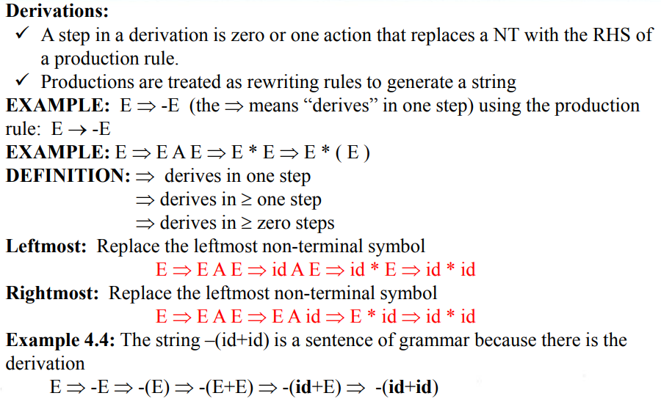

Slide 13
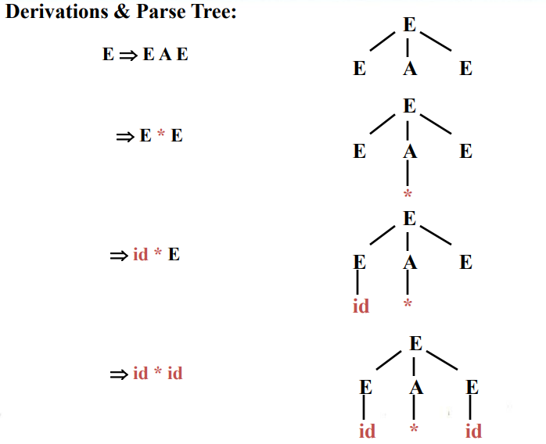

Slide 14
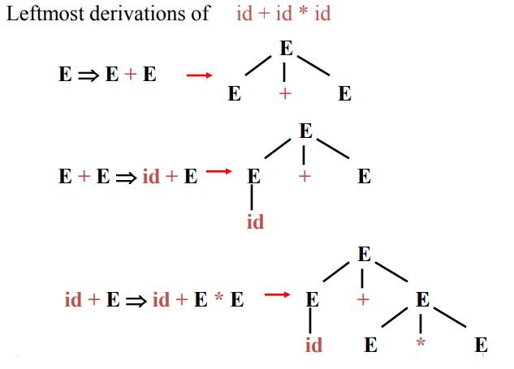
Consider the expression grammar:
E → E+E | E*E | (E) | -E | id

Slide 15
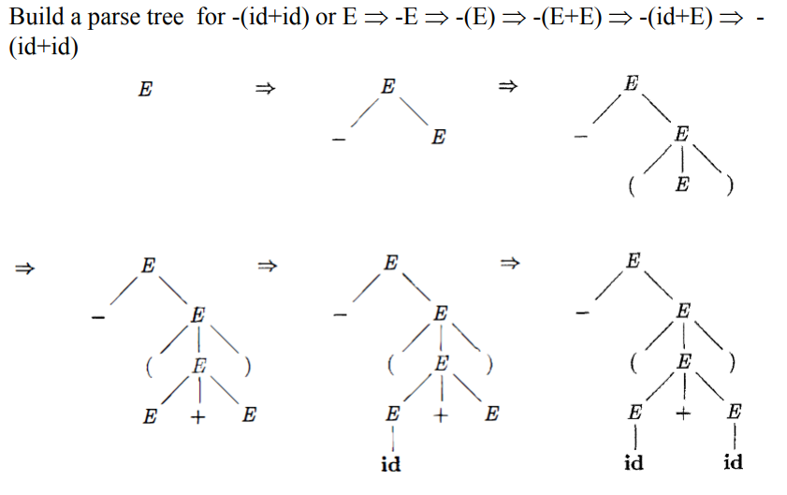
Example:

Slide 16
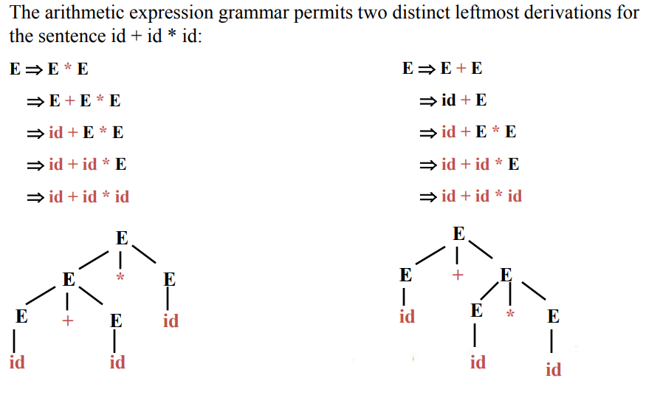
Example:

Slide 17
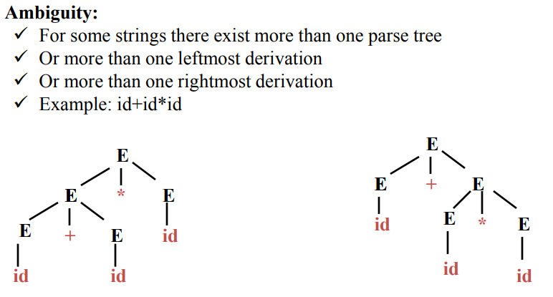

Slide 18
Writing Grammar
Elimination of left recursion:
A grammar is left recursive if it has a non-terminal A such that there is a derivation A→ Aα
Top down parsing methods can’t handle left-recursive grammars.
A simple rule for direct left recursion elimination:
For a rule like:
A → A α|β
We may replace it with
A → β A'
A' → α A' | ɛ

Slide 19
Example: Consider the following grammar for arithmetic expression:
E → E + T | T
T → T * F | F
F → (E) | id
Eliminating the immediate left recursion to the production for E and then T, we obtain
E → T E'
E' → + T E'
T → F T'
T' → * F T'
F → ( E ) │id

Slide 20
Left factoring:
Left factoring is a grammar transformation that is useful for producing a grammar suitable for predictive or top-down parsing.
Consider following grammar:
Stmt → if expr then stmt else stmt | if expr then stmt
On seeing input if it is not clear for the parser which production to use
We can easily perform left factoring:
If we have A→αβ1 | αβ2 then we replace it with
A → αA'
A' → β1 | β2

Slide 21
Algorithm:
For each non-terminal A, find the longest prefix α common to two or more
of its alternatives. If α≠ ɛ, then replace all of A-productions A→αβ1| αβ2|
…|αβn|γ by
A → αA' | γ
A' → β1 |β2 | … | βn
Example:
S → i E t S | i E t S e S | a and E → b; here i, t, e stands for if, then
and else, E and S for “expression” and “statement”. Left factored the grammar
S → i E t S S' | a , S' → e S | ɛ and E → b

Slide 22
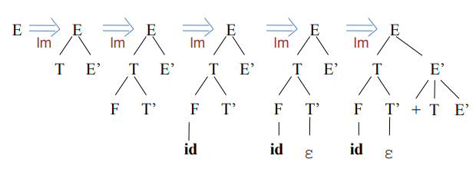
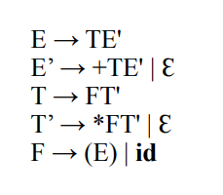
Top-Down Parsing: A Top-down parser tries to create a parse tree from the root towards the leafs scanning input from left to right. It can be also viewed as finding a leftmost derivation for an input string Example: id+id*id

Slide 23
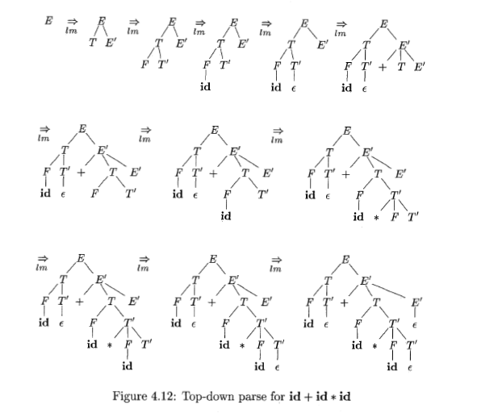
Top-Down Parsing:

Slide 24
Recursive descent parsing:
Consists of a set of procedures, one for each nonterminal
Execution begins with the procedure for start symbol
A typical procedure for a non-terminal
General recursive descent may require backtracking
The previous code needs to be modified to allow backtracking
In general form it cant choose an A-production easily.
So we need to try all alternatives
If one failed the input pointer needs to be reset and another alternative should be tried
Recursive descent parsers cant be used for left-recursive grammars

Slide 25
First and Follow
First() is set of terminals that begins strings derived from
If α→ɛ then is also in First(ɛ)
In predictive parsing when we have A → α|β, if First(α) and First(β) are disjoint sets then we can select appropriate A-production by looking at the next input
Follow(A), for any nonterminal A, is set of terminals a that can appear immediately after A in some sentential form
If we have S => αAaβ for some αand βthen a is in Follow(A)
If A can be the rightmost symbol in some sentential form, then $ is in Follow(A)

Slide 26
Computing First
To compute First(X) for all grammar symbols X, apply following rules until no more terminals or ɛ can be added to any First set:
If X is a terminal then First(X) = {X}.
If X is a nonterminal and X→Y1 Y2 … Y𝑘 is a production for some k>=1, then place a in First(X) if for some i a is in First(Y𝑖) and ɛ is in all of First(Y1),…,First(Y𝑖−1) that is Y1 … Y𝑖−1 => ɛ. if ɛ is in First(Y𝑗) for j=1,…,k then add ɛ to First(X).
If X → ɛ is a production then add ɛ to First(X)

Slide 27
Computing follow
To compute First(A) for all non-terminals A, apply following rules until nothing can be added to any follow set:
Place $ in Follow(S) where S is the start symbol
If there is a production A→ αBβ then everything in First(β) except ɛ is in Follow(B).
If there is a production A → B or a production A → αBβ where First(β) contains ɛ, then everything in Follow(A) is in Follow(B)

Slide 28
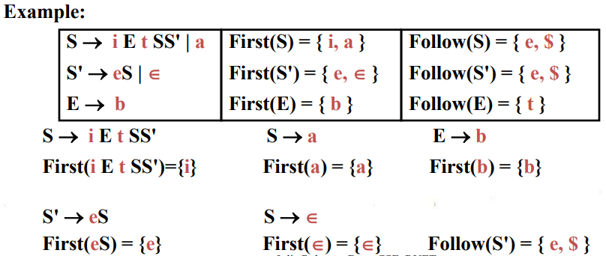

Slide 29
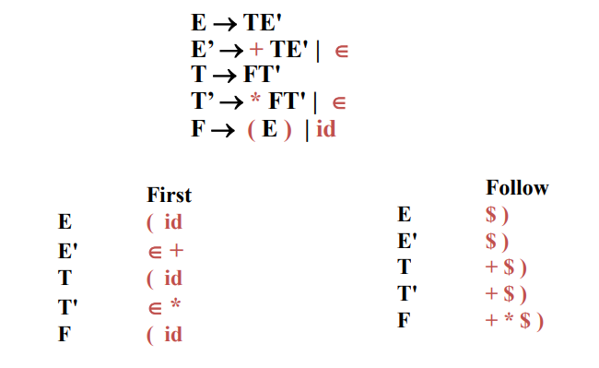
Example:

Slide 30
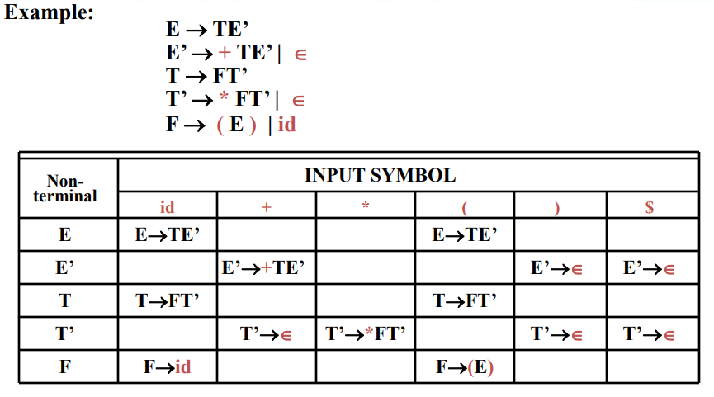
Parsing Table

Slide 31
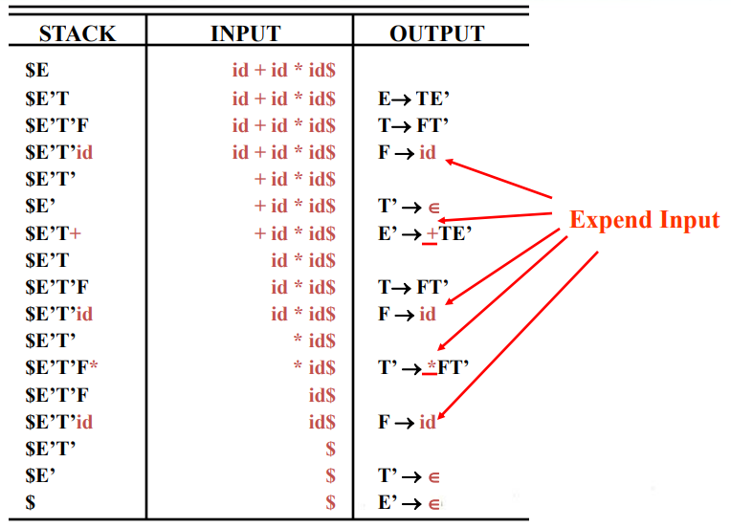
Moves made by a predictive parser on input id + id * id

Slide 32
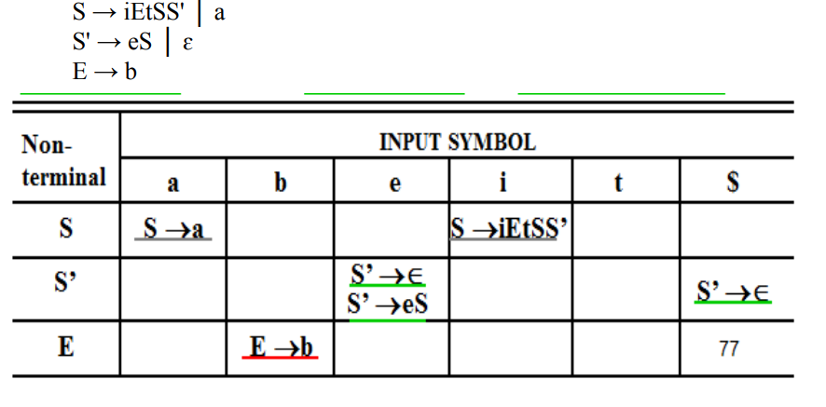
Example

